Slide 1
Class 8
Rotation

Slide 2
Circular Motion Review
A pilot performs an evasive maneuver by diving vertically at 310 m/s. If he can withstand an acceleration of 9.0 g’s without blacking out, at what altitude must he begin to pull out of the dive to avoid crashing into the sea?
Notes:
1.1 km

Slide 3
Before we start
360 degrees or 2𝝅 radians in a circle
Circumference of a circle is 2𝝅r
Θ = l/r (Theta is equal to the arc length subtended by the angle theta in radians over the radius of the circle)
Period is the inverse of frequency

Slide 4
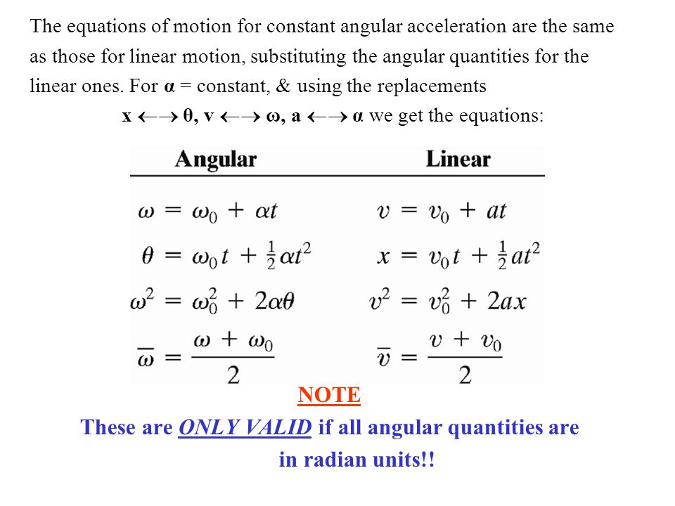
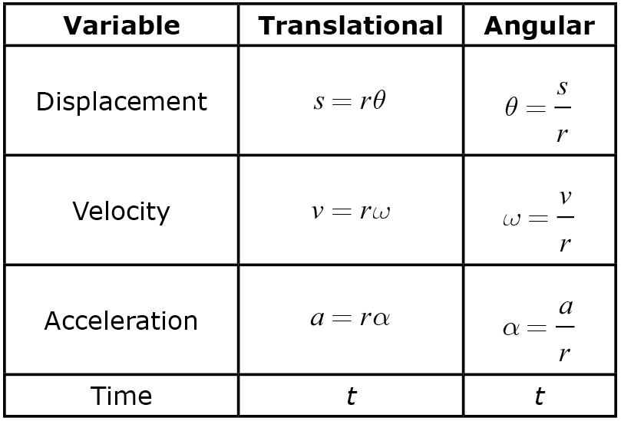
Angular Equations
This is the tangential linear acceleration
Notes:
Angular acceleration is change in angular velocity over time, and angular velocity is change in theta over time
Circular acceleration uses the same equation as the past
Frequency is equal to angular velocity over 2pi

Slide 5
Speed and acceleration on a merry-go-round
What is the linear speed of a child seated 1.2 m from the center of a steadily rotating merry-go-round that makes one complete revolution in 4.0s? What is her acceleration?

Slide 6
Bike
A bicycle slows down uniformly from v = 8.4 m/s to rest over a distance of 115 m. Each wheel and tire has an overall diameter of 68 cm. Determine (a) the angular velocity of the wheels at the initial instant, (b) the total number of revolutions each wheel rotates in coming to rest, © the angular acceleration of the wheel, and (d) the time it took to come to a stop.

Slide 7
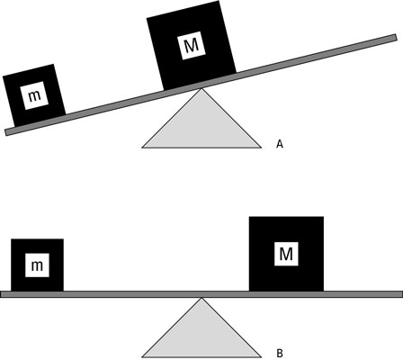
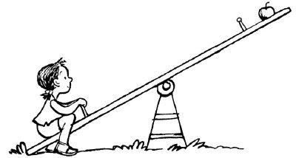
Torque
Notes:
Pushing a door - example
The angular acceleration of the door is proportional not only to the magnitude of the force, but also directly proportional to the perpendicular distance from the axis of rotation to the line along which the force acts - distance is called lever/moment arm, labeled as r

Slide 8
What is the maximum torque exerted by a 55-kg person riding a bike if the rider puts all her weight on each pedal when climbing a hill? The pedals rotate in a circle of radius 17 cm.

Slide 9
If you still don’t get torque, just think of wrenches

Slide 10
Rotational Inertia

Slide 11
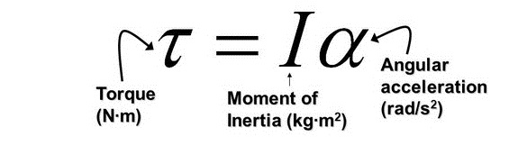
Rotational Inertia
Rotational equivalent of Newton's second law
Moment of Inertia is going to be different for different shapes
Notes:
Derive this
f=ma, f=mra, t = mr^2a

Slide 12
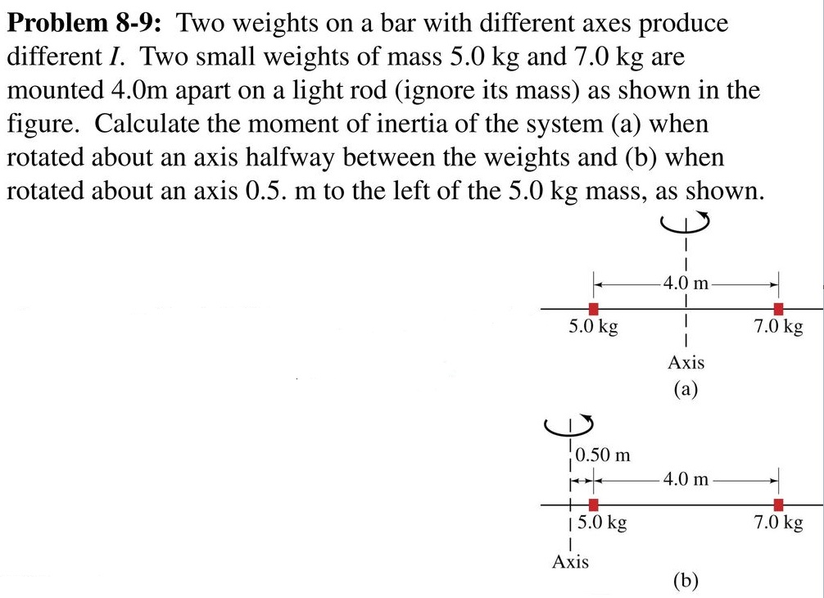
Notes:
I = net mass * r^2 a) 48 kg*m^2
b) 143 kg*m^2

Slide 13
A 15N force is applied to a cord wrapped around a pulley of mass M = 4 kg and radius R = 33 cm. The pulley is observed to accelerate uniformly from rest to reach an angular speed of 30 rad/s in 3 s. If there is a frictional torque , torque = 1.1 m*N, determine the moment of inertia of the pulley. The pulley is assumed to rotate about its center.

Slide 14
Rotational Kinetic Energy
Like regular kinetic energy
K = ½*I*⍵

Slide 15
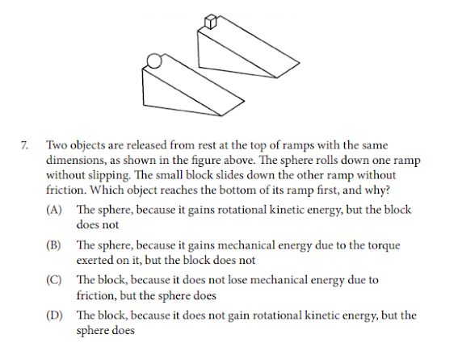

Slide 16
Angular Momentum
Denoted by L
L = I⍵
Σ𝛕 = ΔL/Δt
Law of conservation of angular momentum
The total angular momentum of a rotating body remains constant if the net torque acting on it is zero

Slide 17
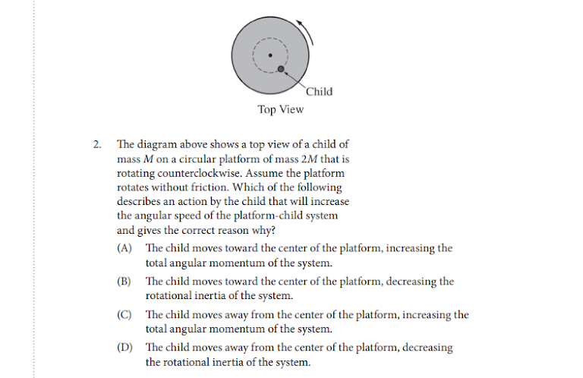

Slide 18
A horizontally mounted wheel of radius r is initially at rest, and then begins to accelerate constantly until it has reached an angular velocity ω after 5 complete revolutions. What was the angular acceleration of the wheel?
Notes:
ω^2/20π

Slide 19
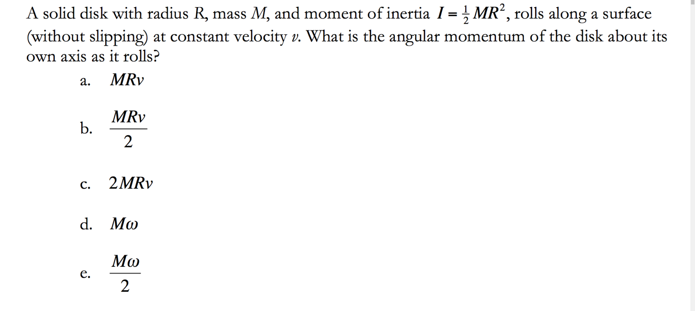
Notes:
B

Slide 20
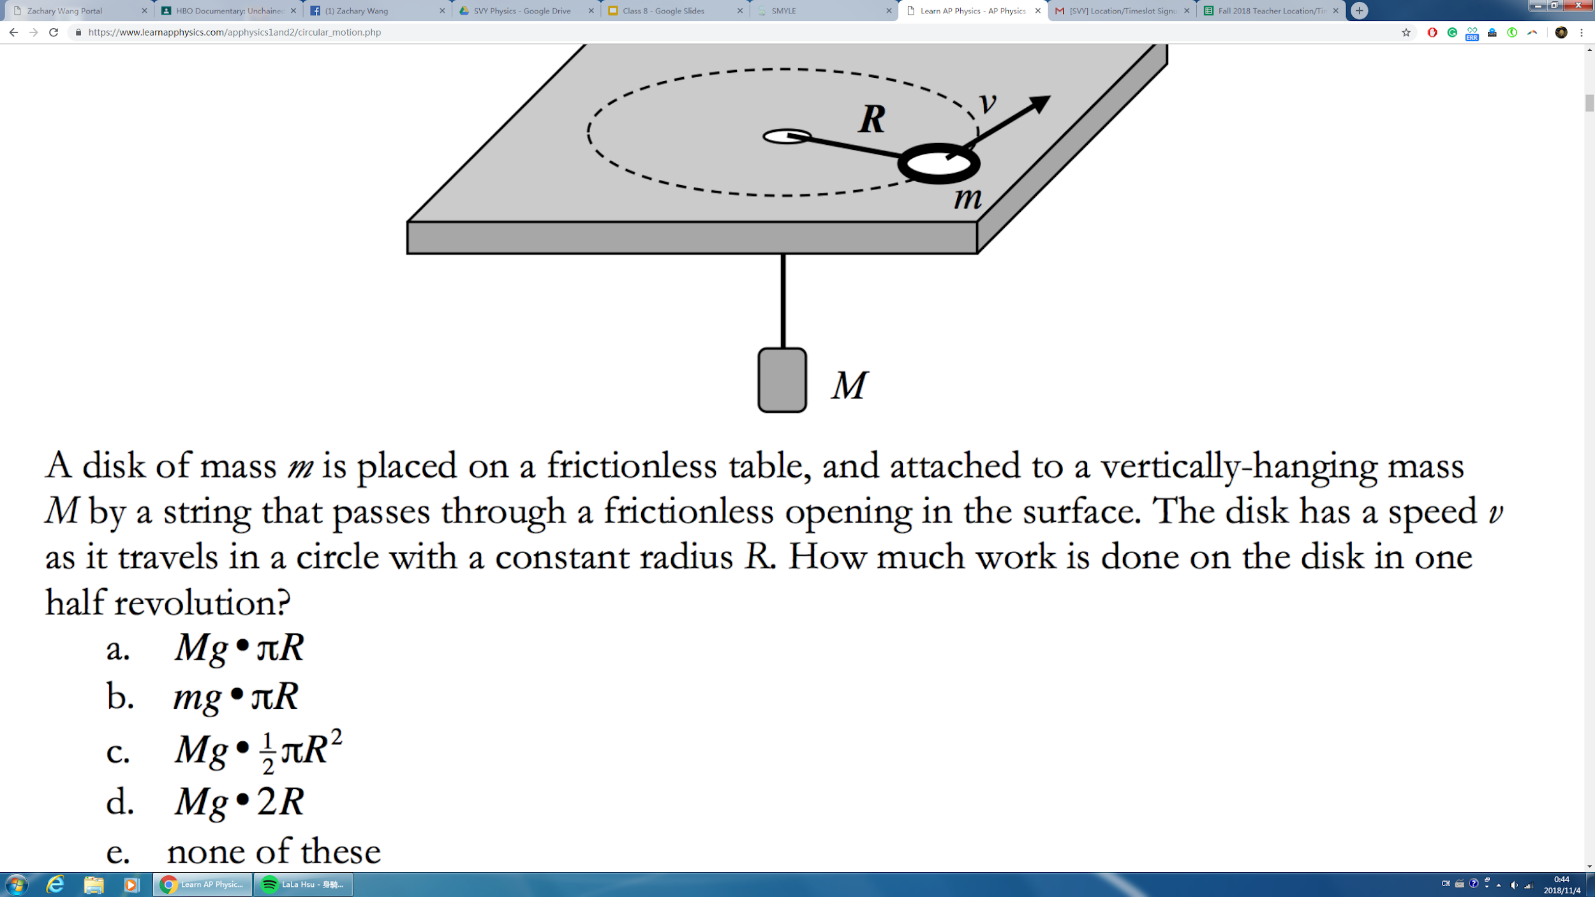
Notes:
E

Slide 21
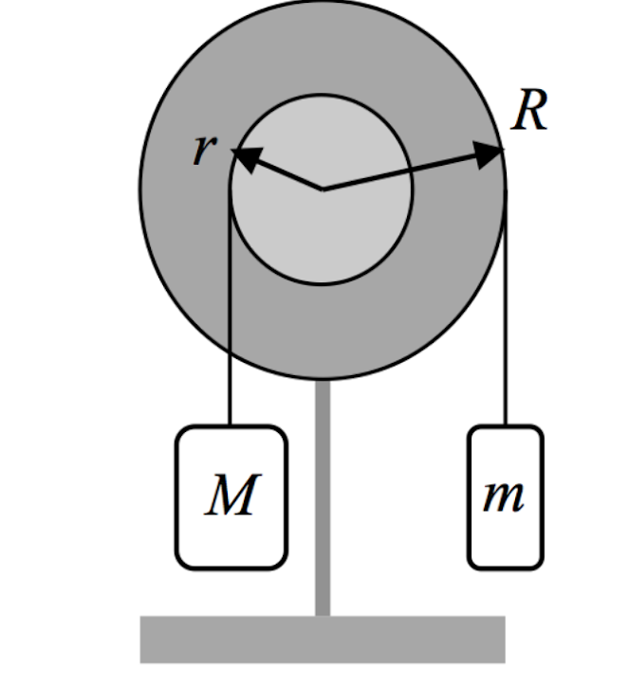
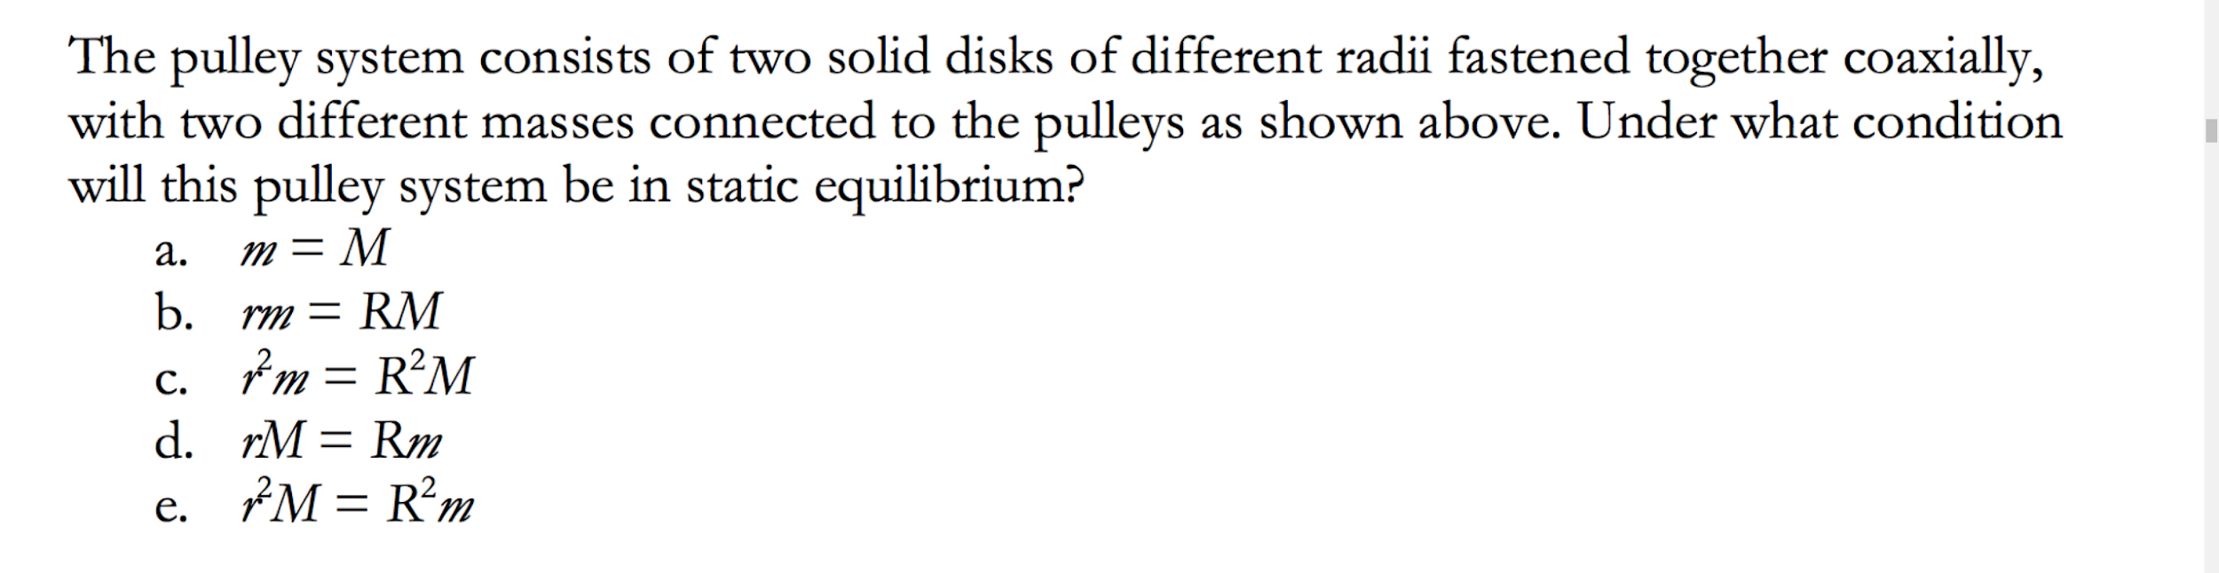
Notes:
D

Slide 22
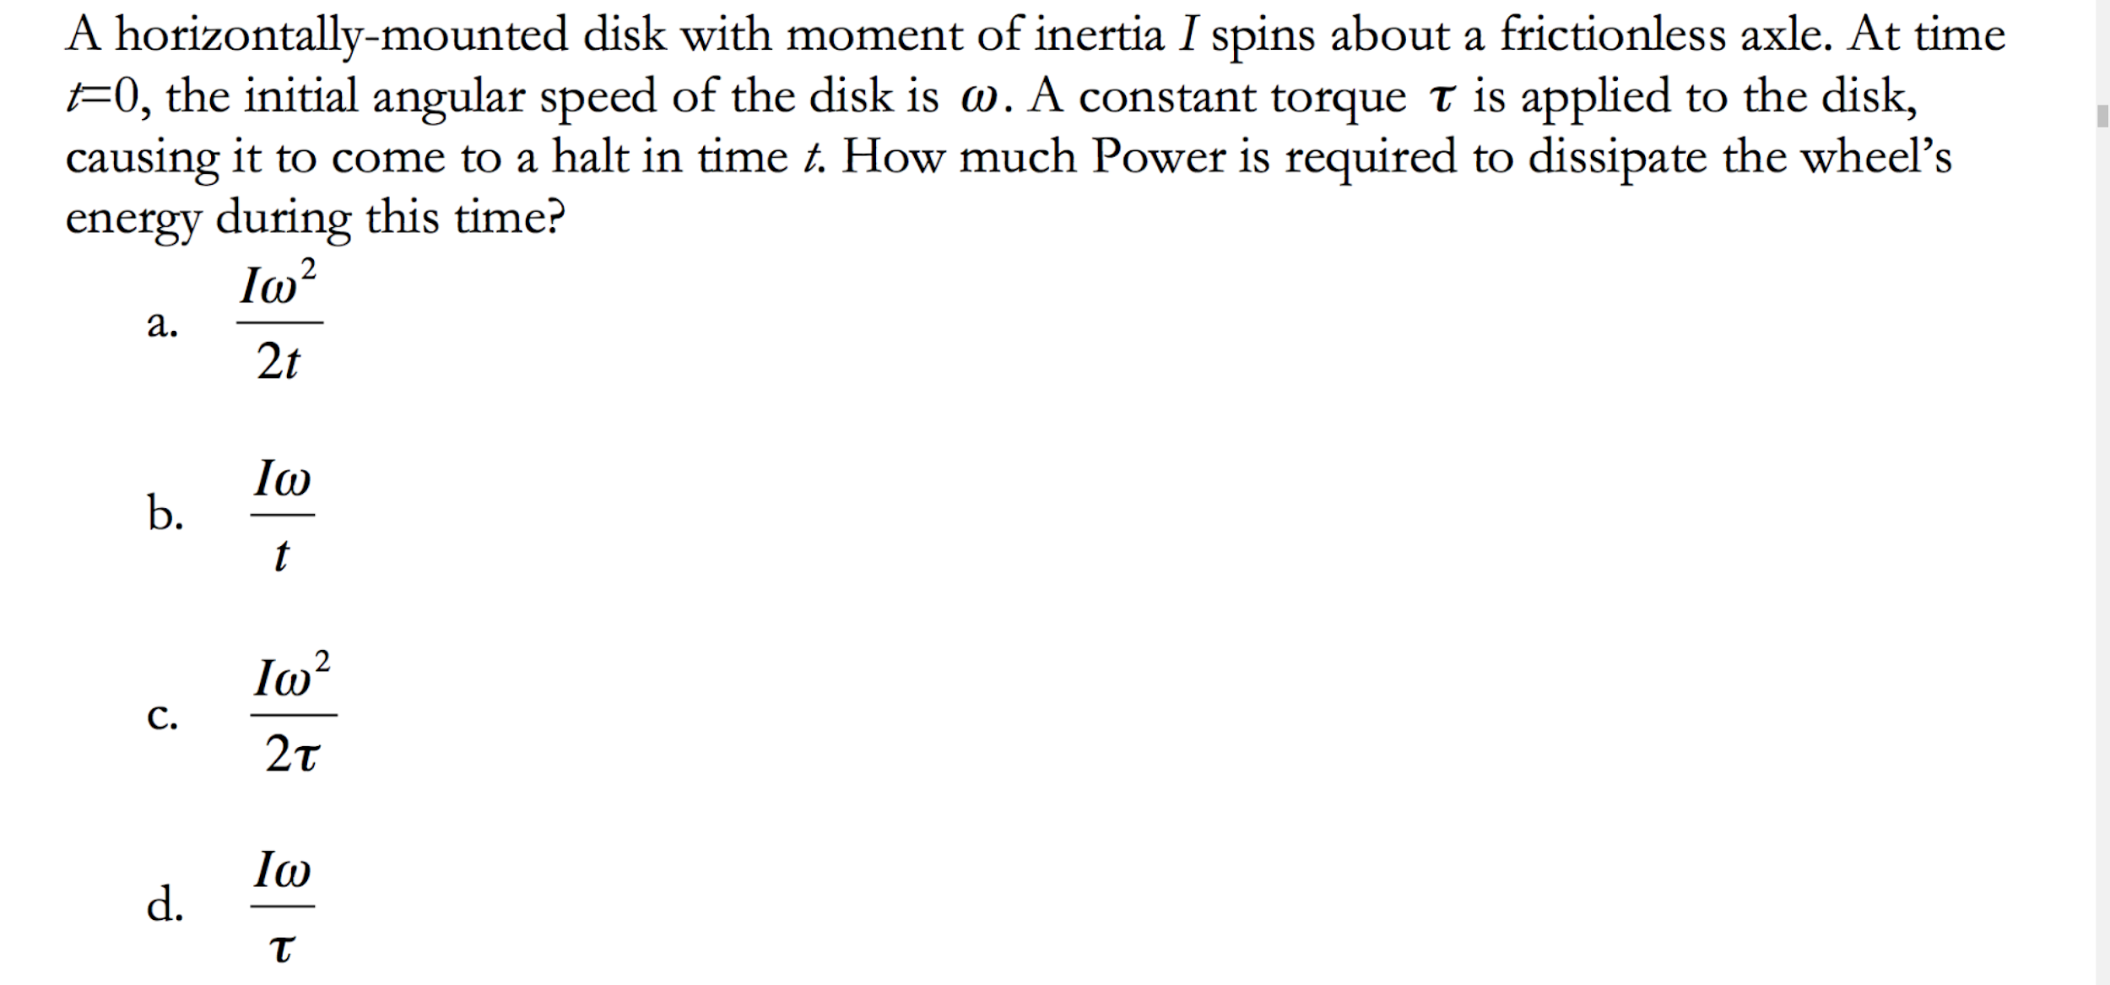
Notes:
A - work kinetic energy theorem

Slide 23
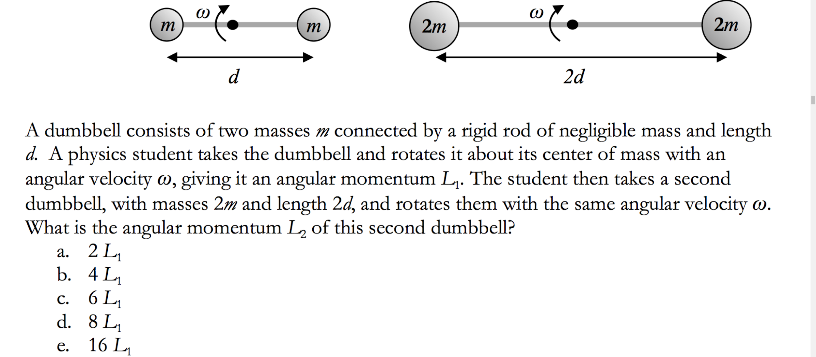
Notes:
D - compare I’s of the two dumbells

Slide 24
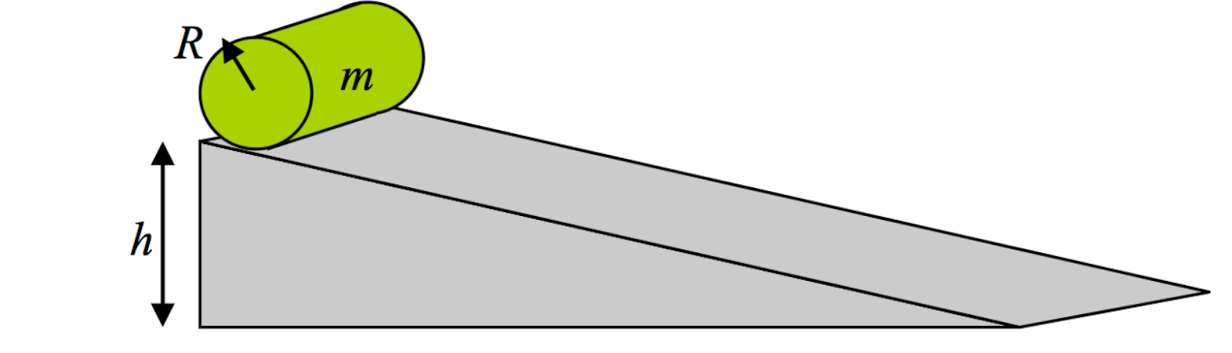
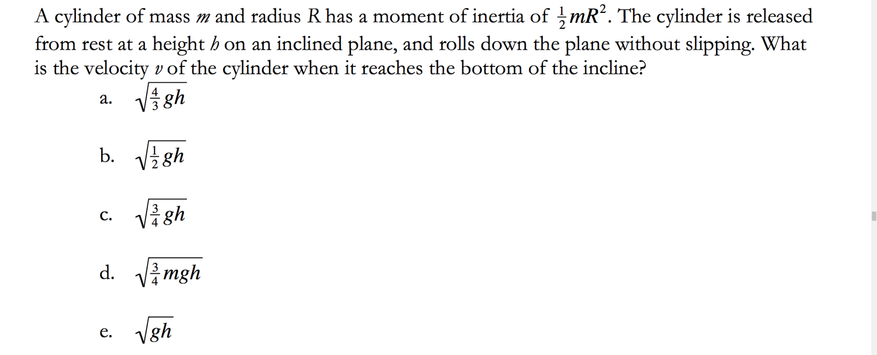
Notes:
A

Slide 25
A 5000 kg rocket is at rest in deep space. The rocket burns fuel pushing 10 kg of exhaust gases rearward at 4000 m/s. This process takes 10 s. During the time interval what average force is applied to the rocket?
Notes:
4000N

Slide 26
A group of ten friends, each of mass 50kg, want to test the strength of a trampoline. At their highest jump, each friend is 2m above the trampoline. They all land on the trampoline at the same time and decelerate at a constant rate to a point of zero velocity over a period of 0.5s. The trampoline has a threshold of 5000N, above which it breaks. Do the friends succeed in breaking their trampoline?
Notes:
Yes; they exert a force of 6325N

